Slide 1
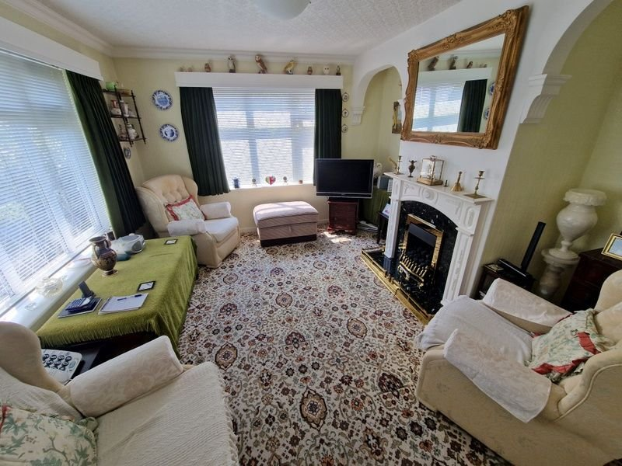
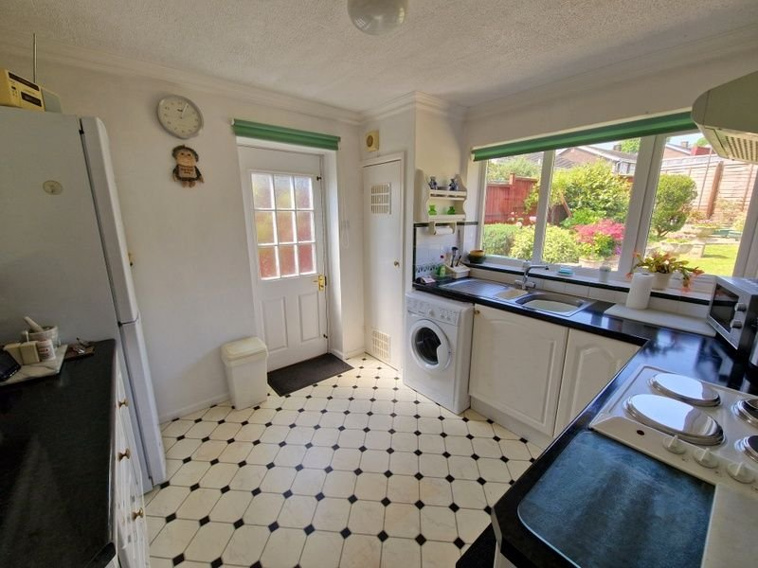
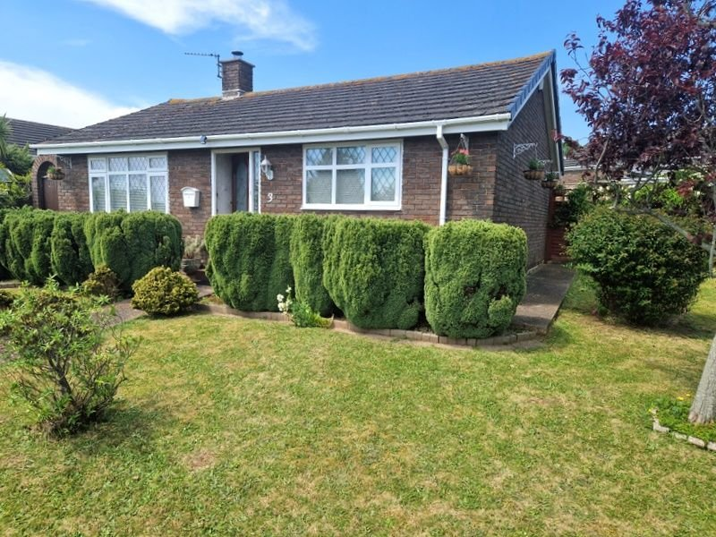
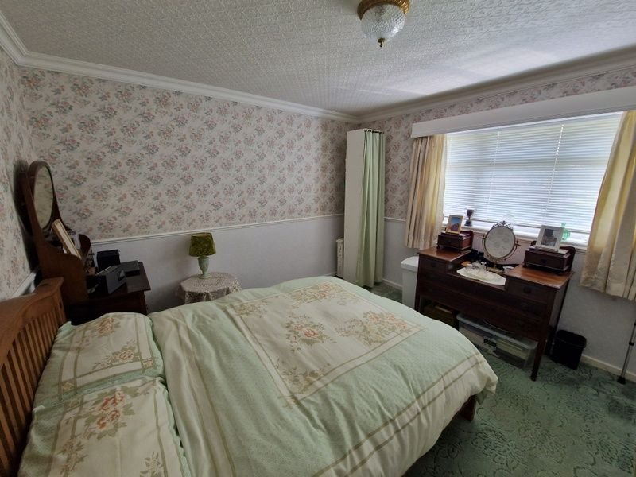
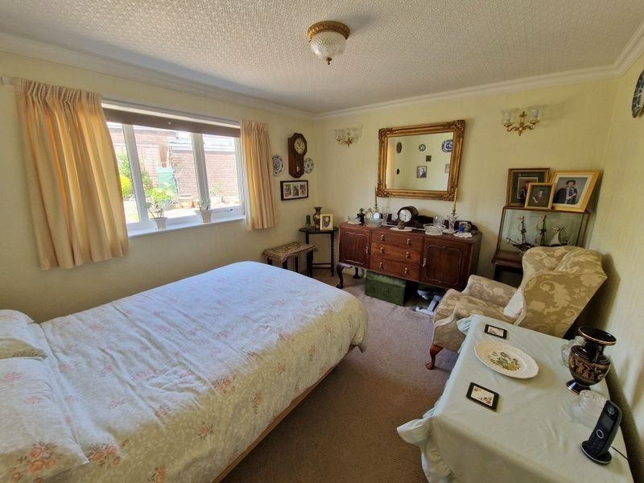
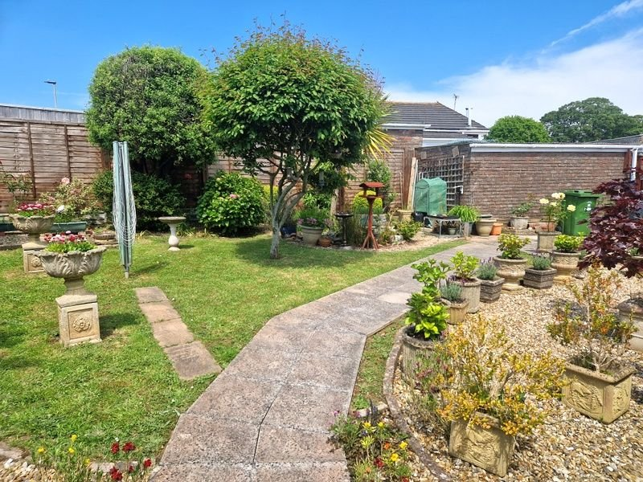
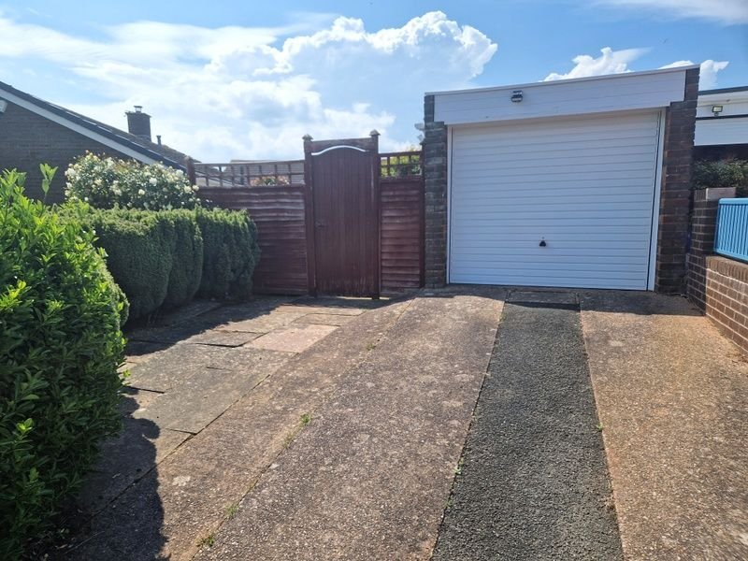
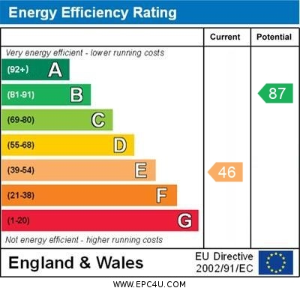
www.pennys.net
3 Brixington Drive, Exmouth, EX8 4HL
GUIDE PRICE £380,000
TENURE Freehold
A Well Presented Detached Bungalow Enjoying Beautiful Corner Plot Gardens, Driveway And Garage, Located In A Convenient Position Close To Bus Routes, Shops And Other Amenities
Dual Aspect Lounge * Kitchen * Two Double Bedrooms * Bathroom * Separate Wc * Double Glazed Windows * Viewing Recommended
Pennys Estate Agents Limited for themselves and for the vendor of this property whose agents they are give notice that:- (1) These particulars do not constitute any part of an offer or a contract. (2) All statements contained in these particulars are made without responsibility on the part of Pennys Estate Agents Limited. (3) None of the statements contained in these particulars are to be relied upon as a statement or representation of fact. (4) Any intending purchaser must satisfy himself/herself by inspection or otherwise as to the correctness of each of the statements contained in these particulars. (5) The vendor does not make or give and neither do Pennys Estate Agents Limited nor any person in their employment has any authority to make or give any representation or warranty whatever in relation to this property.
PENNYS ESTATE AGENTS
2 Rolle House, Rolle Street, Exmouth, Devon, EX8 2SN
Tel: 01395 264111 EMail: help@pennys.net

Slide 2
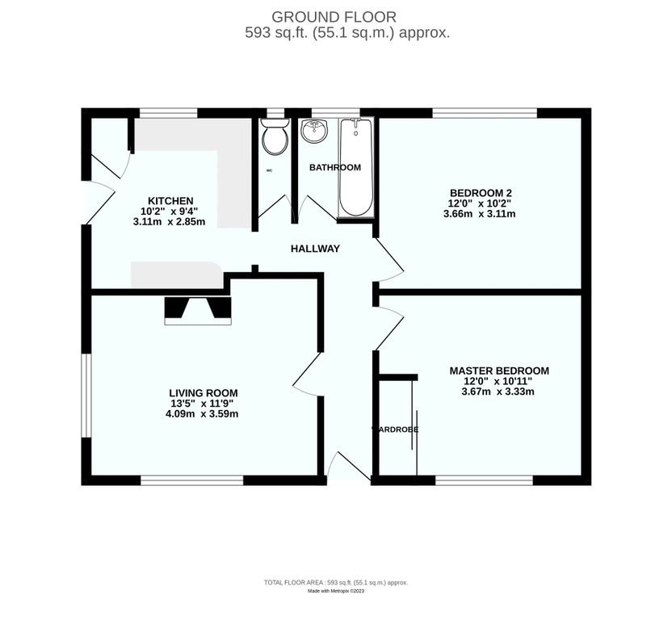
3 Brixington Drive, Exmouth, EX8 4HL
THE ACCOMMODATION COMPRISES: Front door with outside light with arch pattern window insert giving access to:
RECEPTION HALL: Access to loft space, telephone point, doors giving access to all rooms.
LOUNGE/DINING ROOM: 4.09m x 3.58m (13'5" x 11'9") A bright dual aspect room with double glazed windows to front and side aspects, TV point and telephone point, fire surround housing living flame effect coal gas fire, two feature arched wall recess.
KITCHEN: 3.1m x 2.84m (10'2" x 9'4") Fitted with a range of worktops with cupboards, drawer units and plumbing for automatic washing machine beneath, inset four ring electric hob with extractor hood over and built-in oven below. Wall mounted cupboards, tiled surrounds, space for upright fridge/freezer, cupboard housing gas boiler for hot water, double glazed window to rear aspect, door giving access to the rear garden.
BEDROOM 1: 3.66m x 3.33m (12'0" x 10'11") Double glazed window to front aspect, built-in wardrobes.
BEDROOM 2: 3.66m x 3.1m (12'0" x 10'2") Double glazed window to rear aspect.
BATHROOM: 1.78m x 1.47m (5'10" x 4'10") With bath and Mira shower over, shower curtain and rail, pedestal wash hand basin, double glazed window with patterned glass, fully tiled walls.
SEPARATE WC: Fitted with WC, double glazed window with patterned glass.
OUTSIDE: The property commands an impressive corner position with attractive lawned gardens to the front and side of the bungalow with colourful flower and shrub beds with driveway providing off road parking leading to a single garage with outside light. Side gates to either side of the bungalow give access through to delightful rear garden offering abundance of colour from a variety of shrubs and trees. There is decorative stone flower beds and pathways, water feature, patio sun terrace ideal for outside entertaining.
FLOOR PLAN:

